Slide 1
Crossword Game
Software Development 1 Mini Group Project
Sayfullah, Rayyan, Fayaaz, Kalid

Slide 2

Project
About the Project
Strategies
Outcomes and testing
Critical Reflection
Improvements for next time

Slide 3

Introduction
Our group has chosen to create a web-based crossword game with the purpose of making an educational fun tool helping users to improve vocabulary and problem-solving skills.
Our system will allow players to input their answers into a designated bar along with having numbered squares which would correspond to clues on the side. These clues would be revealed and answered by clicking on the appropriate number. Users will be able to type answers into a small bar and if correct will be added to the grid. If the input is incorrect the system will let the user know that what they typed was wrong and that answer won’t be added to the grid. This application will be developed using HTML, CSS and python. The finished product will be deployed via GitHub Pages.

Slide 4
Product design and objectives
The game is going to feature a simple and visually clear interface with:
A grid layout
Readable text
Easy colour-coded navigation between clues Feedback will be helpful, guiding players through the crossword. Once we get the game up and running, we plan to add 2 extra difficulties:
Easy: shorter simpler words (tailored for students)
Hard: Longer more challenging words (better for teachers)

Slide 5
Functional and Nonfunctional requirements
Functional
Non-functional
The crossword will be in a grid layout where players can see the length of the word by counting the number of cells
Players can enter their answer into an input bar below the grid
when a player inputs an answer, either a completion message if correct or an error message if incorrect will appear
Once all words are guessed correctly, a final completion message will pop up to confirm the puzzle is complete
Users will have the option to restart the game at any time by pressing the reset button
A difficulty selection including easy, medium and hard which would vary the grid sizes and complexity of the words
The interface will be simple, clear and easy to navigate so users can quickly understand how to play
Designed to be used by 10–14-year-olds however by adding a difficulty system, older more intelligent people can play
A simple and school appropriate design will keep the game engaging without being distracting
The system will be reliable and robust

Slide 6
User Profiles
Here are user profiles for our stakeholders/players/audience of our game

Slide 7
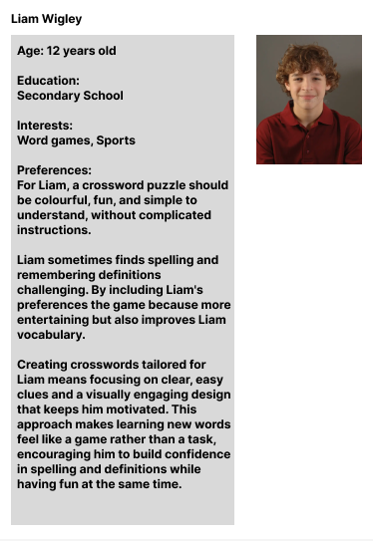
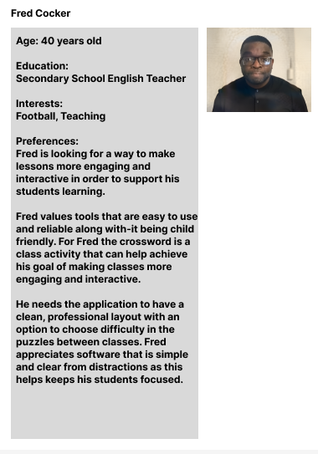
User Profiles

Slide 8
System Requirements
Hardware
Dual core CPU
Minimum 4GB RAM
Minimum resolution of 1280×720
Keyboard and Mouse
Software
Windows 10 or newer
MacOS 10.15 or newer
Google chrome
Microsoft edge
Safari
HTML
CSS
Python Flask
Microsoft Visual Studio Code

Slide 9
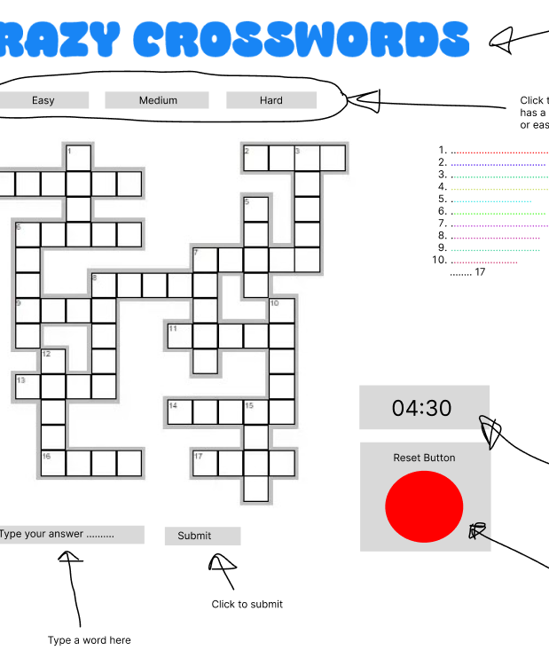
Design for game page

Slide 10
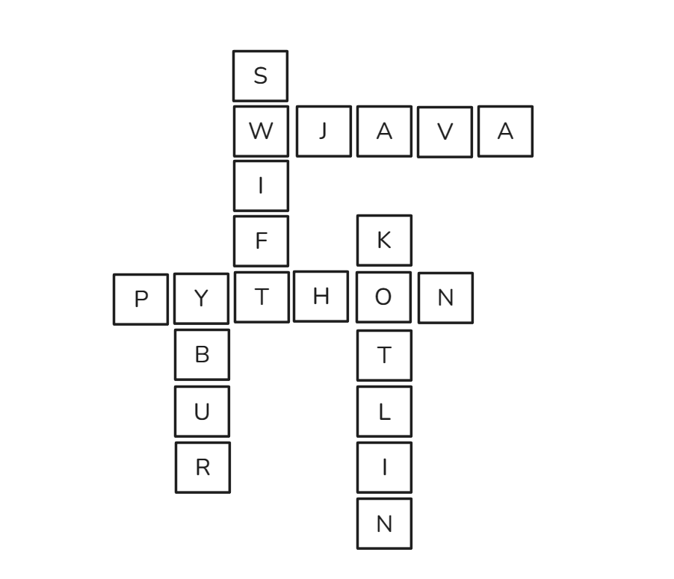
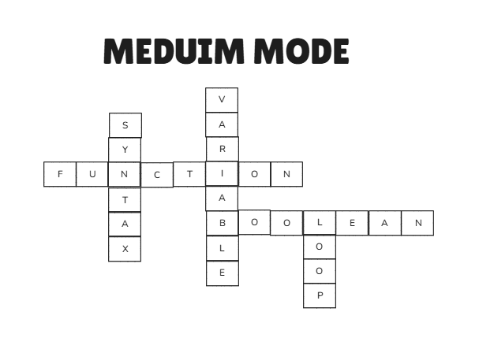
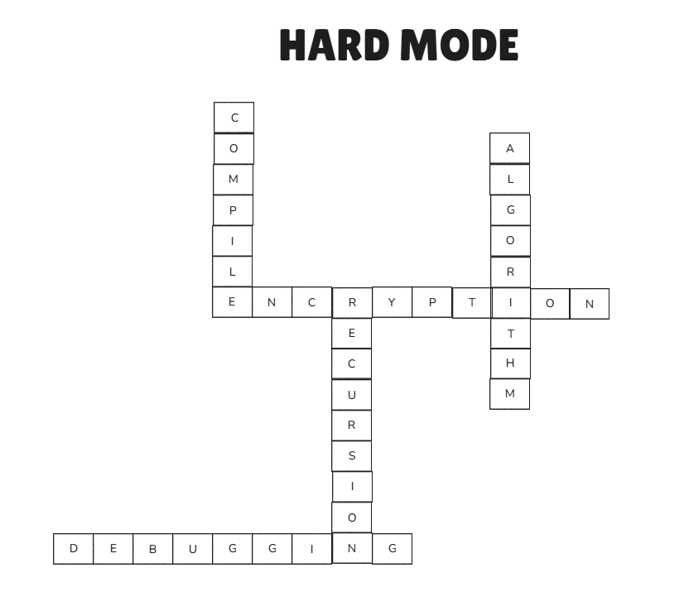
Design for Difficulties
Easy Mode Grid Format Mock-up
Medium Mode Grid Format Mock-up
Hard Mode Grid Format Mock-up

Slide 11
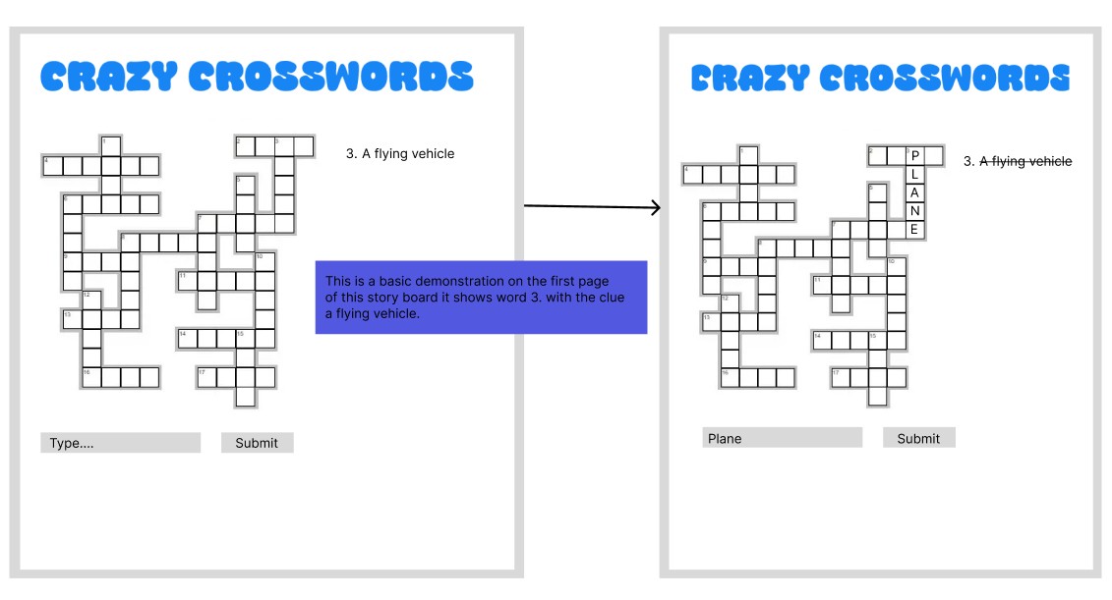
Basic Storyboard

Slide 12
Potential Risks To The Project’s Success
Technical Knowledge, we all have limited knowledge and experience in python and coding in general. This could cause delays and issues in development as we would spend time trying to figure out how to implement the code and our ideas. This is the main issue for our project due to lack of knowledge and experience we may not have it to a great quality.
Trying to add optional features and things to make the game better will be hard for us due to the lack of time given to complete the project. If we spend too many resources on one feature, then we won't be able to focus on important parts and developing the functionality of the game
Testing issues may occur due to various devices not being compatible with our game. Also, we will not be able to receive real user feedback from our target audience which leads to less usability improvements.
Our reliance on external libraries might cause compatibility issues or even if we use external images or other things there could be an issue due to licensing. Also, another issue we will face is conflicting changes on GitHub when we all commit changes at the same time.

Slide 13



Software Development Strategy
Our software development strategy is the spiral methodology, which contains elements of other methods such as waterfall with its clearly defined phases, combined with an iterative development process. It is great for projects that contain a risk element to it, largely used for complicated, expensive projects. The main advantage of the spiral model is the “coil with many loops”. When the spiral model is visually presented, you can see these loops. This is to show the iterative process that you can go back to prior stages even after moving on and correct any mistakes and improve further. This means we can gradually release stages of the new system and make refinements, too, as time passes.

Slide 14
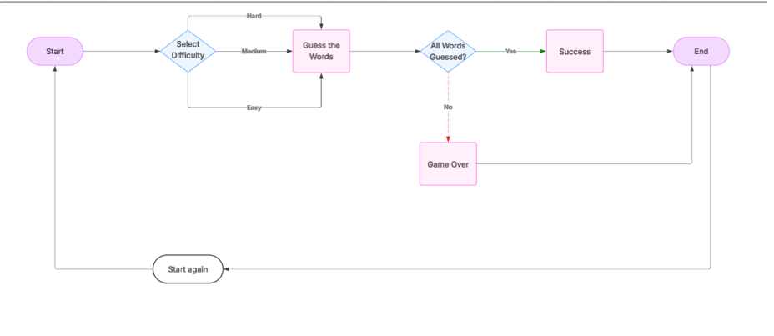
Flowchart

Slide 15
Game State Management
Our crossword game follows a simple system to track the players these sates are :
Start - The game begins by loading up the easiest version of the crosswords along with clues by the side. All words are hidden until guessed corectly.
Win - Win will be achieved when the user manages to complete and solve all the words in the grid correctly. We have implemented a timer that goes up so users can time how quickly they complete the crossword.
lose - Since the crossword does not have a lives system or a time limit to complete the crossword in, it does not have a lose state. However, the game does display an incorrect message when the user inputs an incorrect word.
Draw - this state does not apply to our crossword however it could be added if we include a multiplayer feature in the future however that would require more time and resources.

Slide 16
POST DEVELOPMENT OUTCOMES
After programming our game here are the outcomes and tests and also what we could of done better next time

Slide 17
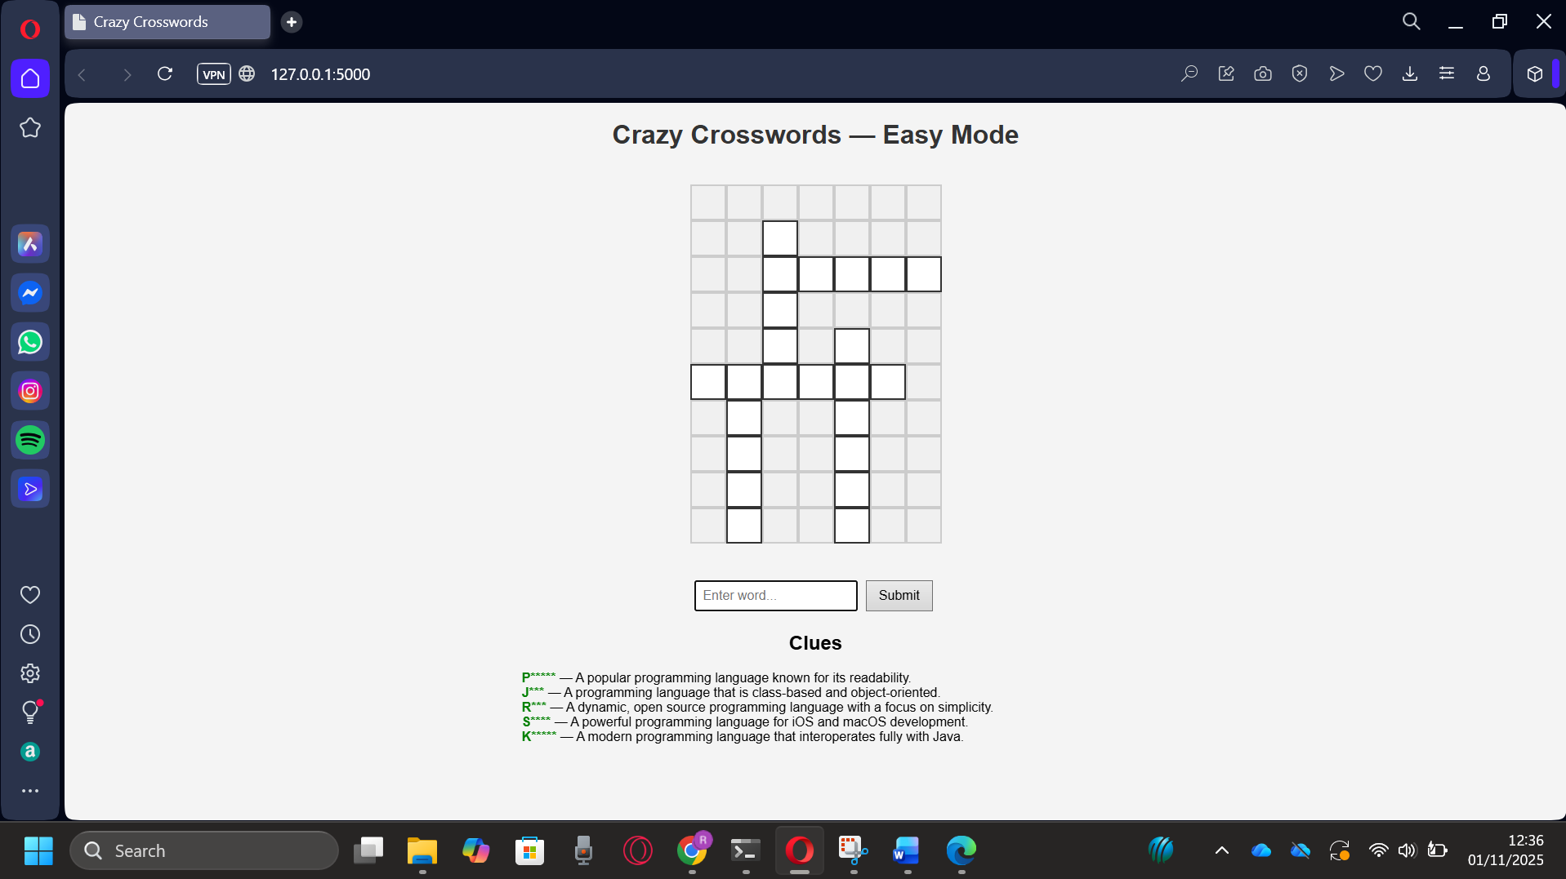
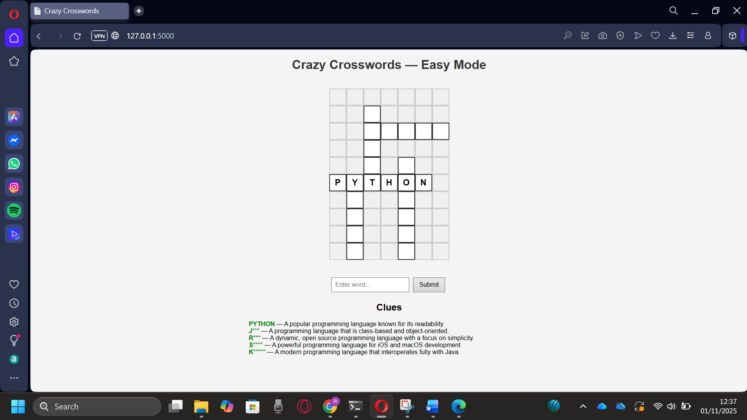
Figure 1: Grid loads successfully
Feature | Expected Result | Actual Result | Pass/Fail
Load crossword grid | The full grid loads onto the website. | See Figure 1 | ✅ Pass
Input answer | User can type answers into the grid. | See Figure 2 | ✅ Pass
Handle incorrcet answer | System should dispay an error message and not include the word in the crossword. | system displays error message and does not include the word in the crossowrd,see figure 3 | ✅ Pass
Timer | System should display a timer that can be stopped and reset. | timer added ontop of the crossowrd and can start stop and be reset, see figure 4 | ✅ Pass
Usability | The grid should be clear, not too hard for the target audience and easy to navigate | grid is clear and easy to understand | ✅ Pass
The grid updates after a word is added | The grid should update after a word is added(works accross all difficuties) | See Figure 6 | ✅ Pass
Accessibility | Controls and instructions should be simple and easy to learn. | No controls and instructions given however game mechanics are simple and dont require much skill to figure out | ❌fail
Default difficulty | default difficulty should be easy. | default difficulty is easy | ✅ Pass
Change difficulty | when difficulty is changed the grid should update to the desired version. | see figure 9 | ✅ Pass
Crossword is colour coded | Crossword is colour coded to the words . | No colours added to match words with hints | ❌fail
Handle Correct answer | System should dispay an correct message and include the word in the crossword. | correct message appears with the word inputted,see figure 11 | ✅ Pass
Figure 2: Typing answers into the grid and it shows

Slide 18
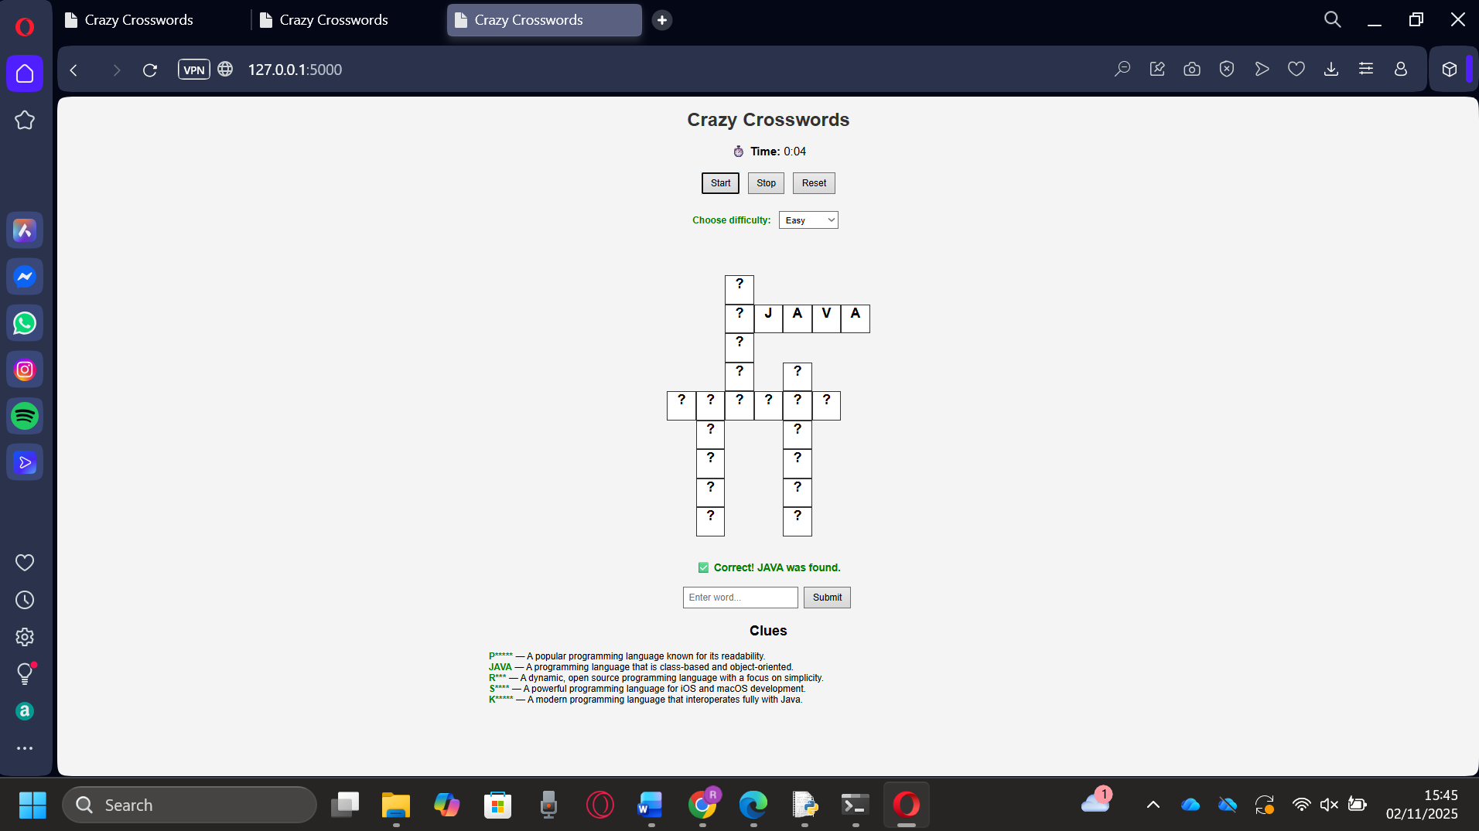
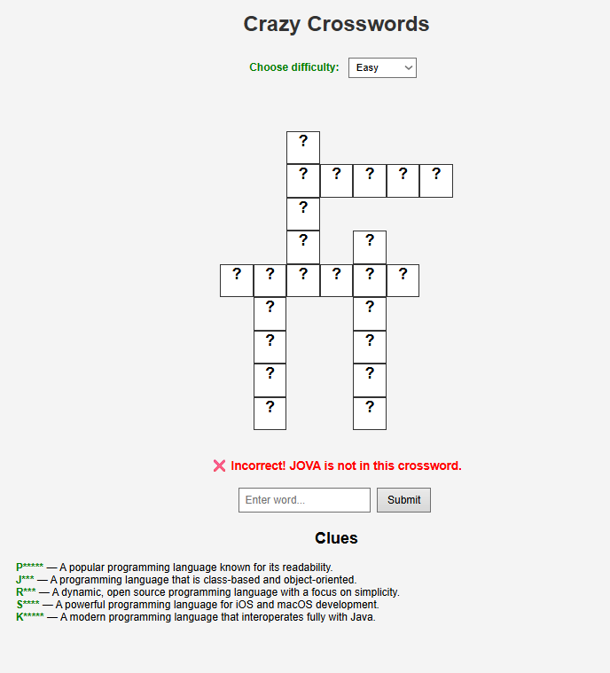

Figure 4 : timer
Figure 3: incorrect message

Slide 19
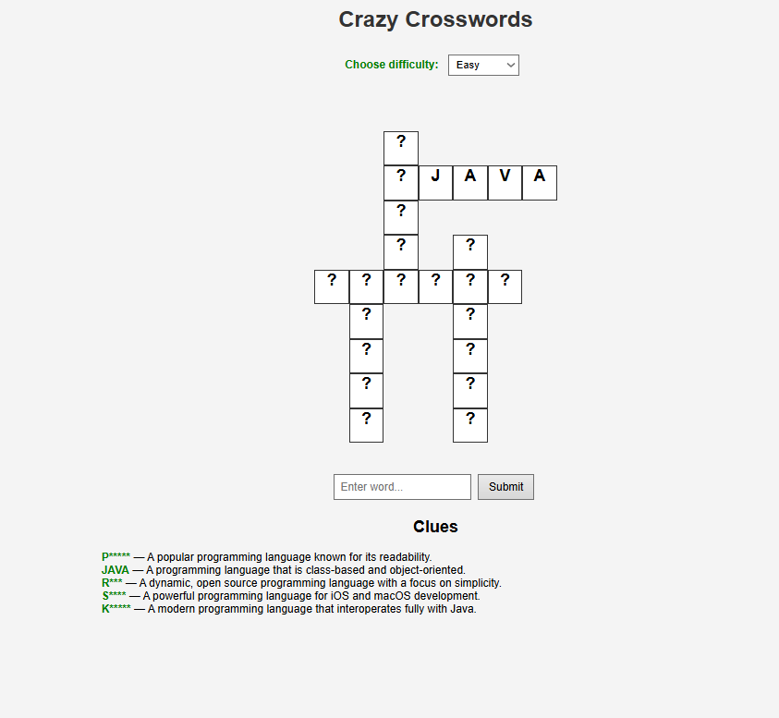
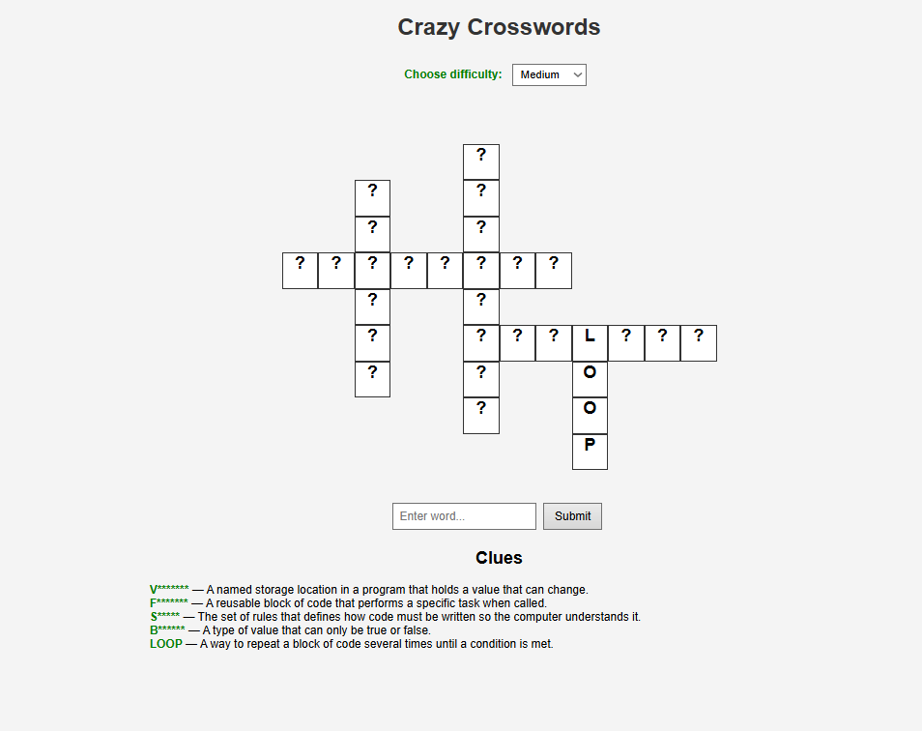
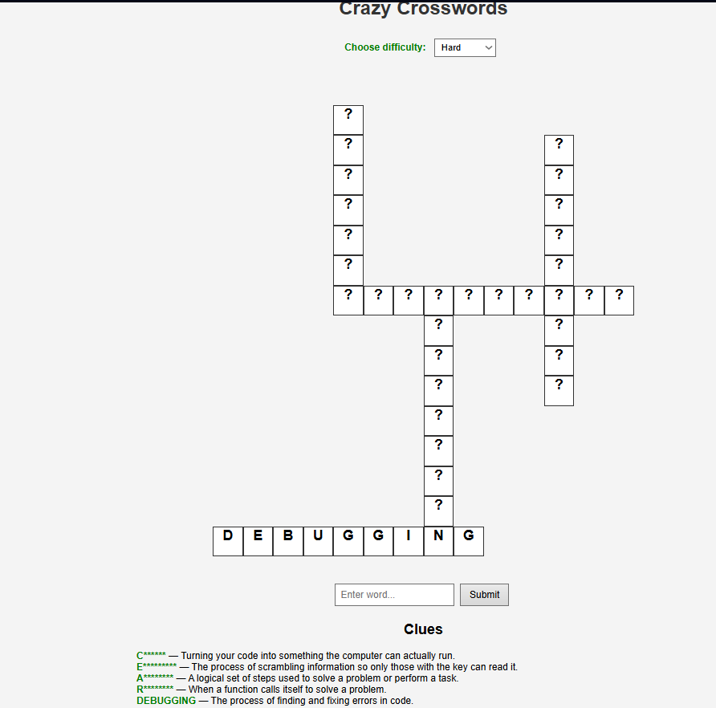
Figure 6: grid updates when a word is added in every difficulty mode

Slide 20
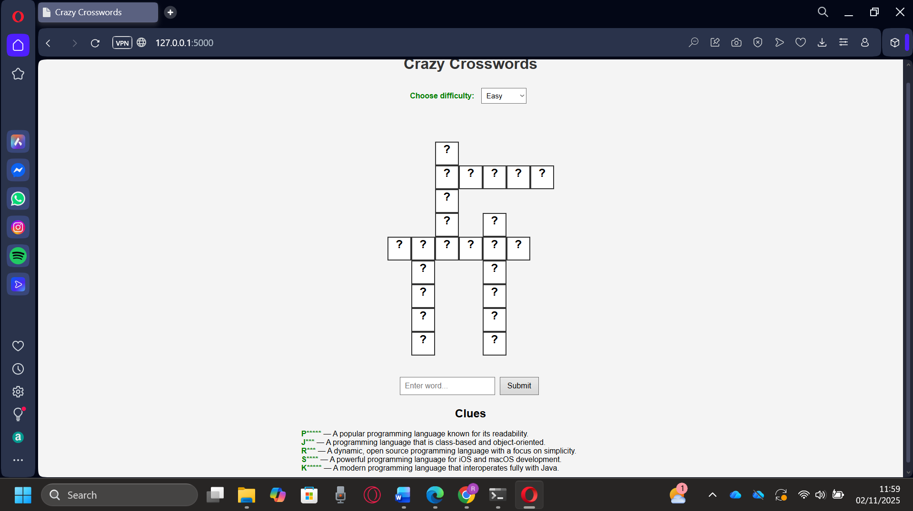
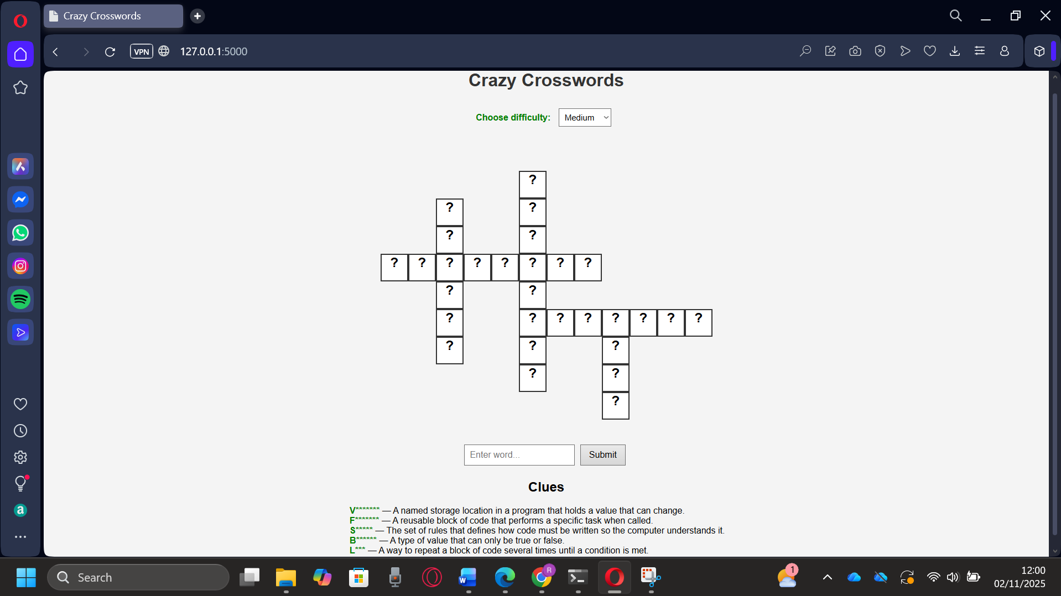
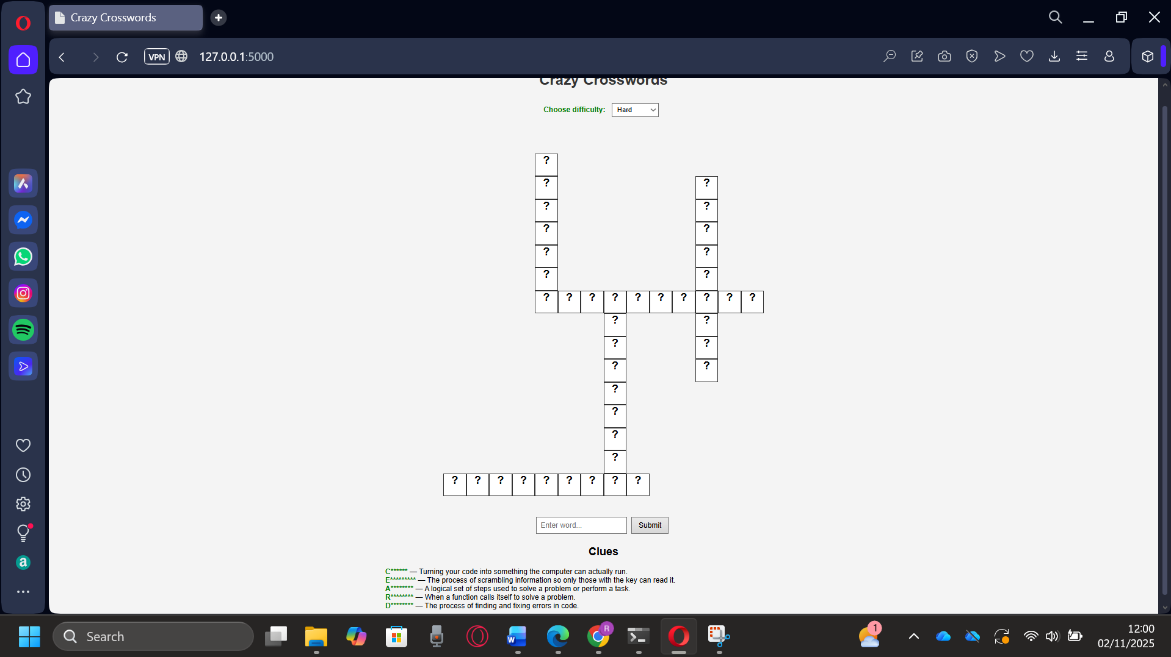
Figure 9: different difficulties load successfully

Slide 21
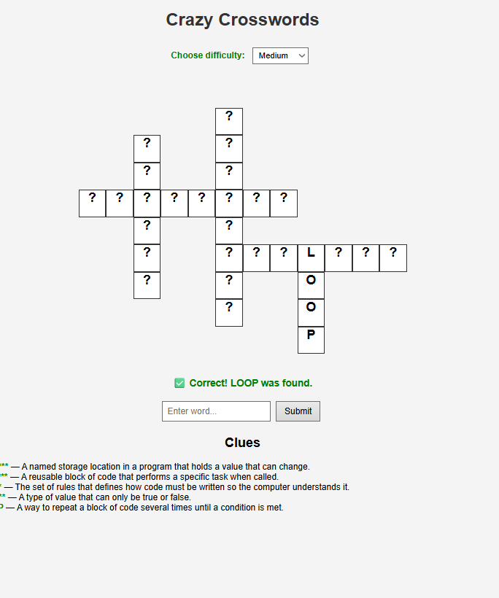
Figure 11: Correct Message

Slide 22
Review of the final game
Overall, the game has its basic functionality and can be played.
There is still much room for improvement, and we can easily make the game better in everyway possible – actual game, the website, visually.
We could integrate APIs (Application Programming Interface) of a dictionary, so there can be a wider range of words available for the crossword that can be generated

Slide 23




Thank you
Fayaaz
Rayyan
Sayfullah
Kalid

